Slide 1
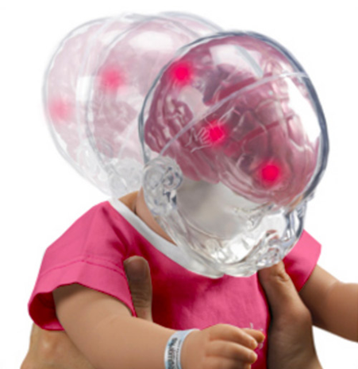
ABUSIVE HEAD TRAUMA (AHT) SHAKEN BABY SYNDROME (SBS)

Slide 2
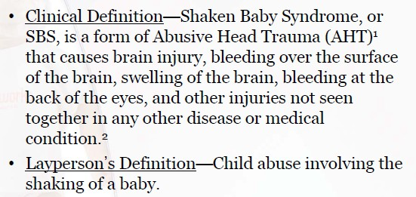
DEFINITIONS
Notes:
Emergency treatment for a baby who has been shaken usually includes life-sustaining measures such as respiratory support and surgery to stop internal bleeding and bleeding in the brain. Doctors may use brain scans, such as MRI and CT, to make a more definite diagnosis.

Slide 3
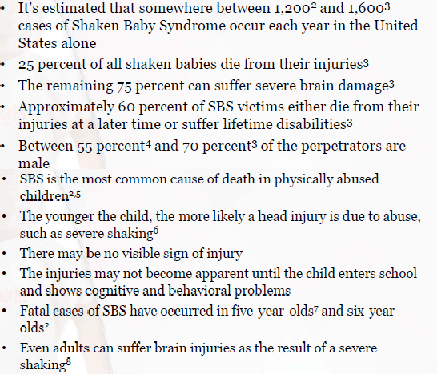
SBS STATS & FACTS

Slide 4
ANIMATION OF HOW SHAKING AN INFANT IS THOUGHT TO INJURE THE BRAIN
Video Animation courtesy of forensic pathologist Dr. Daniel Davis, Expert Digital Solutions, Inc.
Notes:
Watch 35 second video

Slide 5
CHILD ABUSE & NEGLECT
1. Children Receiving Referrals for Abuse & Neglect
2023 Total: Kern County: 14,155
Per 1,000: Kern County: 56.3
California: 433,817
California: 49.0
2. Children found to be Victims of Abuse & Neglect after investigation
2023 Total: Kern County: 2,670
Ages 0-5: Kern County: 1,213
Under 1: Kern County: 421
California: 49,463
California: 21,166
California: 7,033
In 2022, 1 child death was determined to be a result of abuse/neglect by law enforcement or the coroner;
and 19 children sustained severe/serious injuries that required emergency medical intervention
due to abuse or neglect.

Slide 6
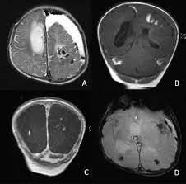
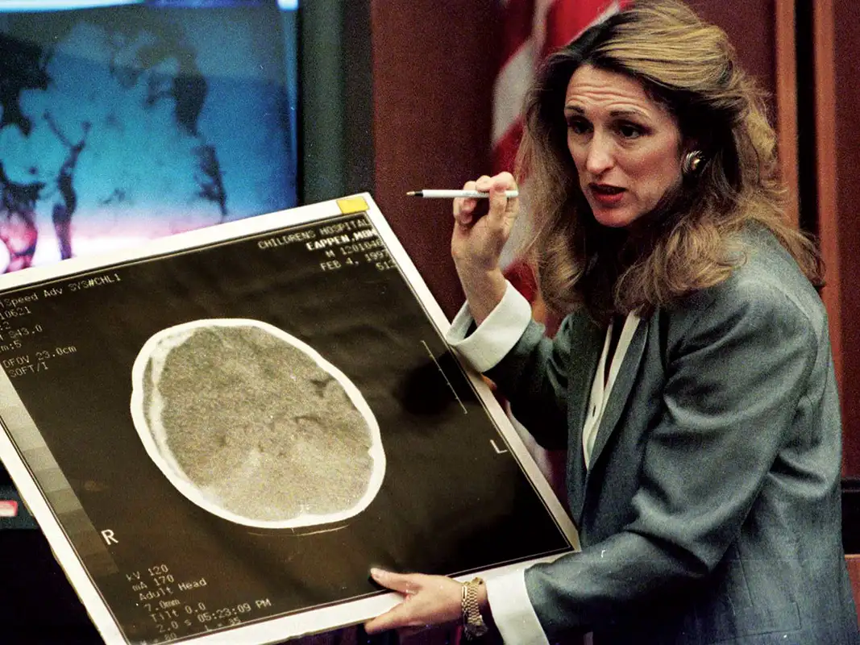
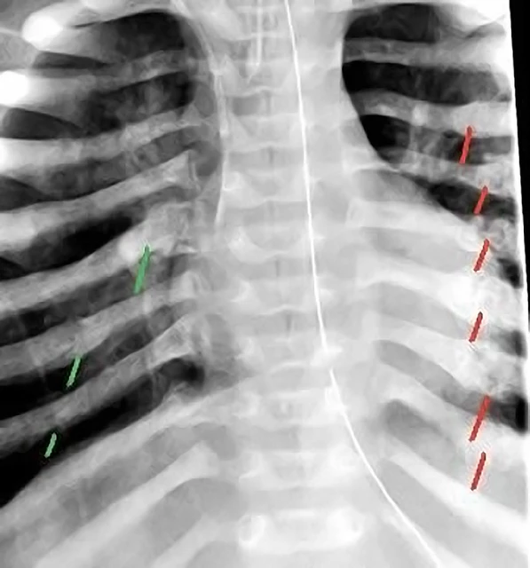
IN KERN COUNTY
Blunt force head trauma accounted for 9 child deaths in years 2017-2022.
Oct. 6, 2017 -Bakersfield man gets 11 years in infant son’s death; https://www.kget.com/news/crime-watch/bakersfield-man-gets-11-years-in-infant-sons-death/
August 28, 2023- Child torturer denied parole for 3 years; https://www.aol.com/child-torturer-denied-parole-3-035900722.html
Notes:
A baby has weak neck muscles and a large, heavy head. Shaking makes the fragile brain bounce back and forth inside the skull and causes bruising, swelling, and bleeding, which can lead to permanent, severe brain damage or death. The characteristic injuries of shaken baby syndrome are subdural hemorrhages (bleeding in the brain), retinal hemorrhages (bleeding in the retina), damage to the spinal cord and neck, and fractures of the ribs and bones. These injuries may not be immediately noticeable. Symptoms of shaken baby syndrome include extreme irritability, lethargy, poor feeding, breathing problems, convulsions, vomiting, and pale or bluish skin. Shaken baby injuries usually occur in children younger than 2 years old, but may be seen in children up to the age of 5.

Slide 8
