Slide 1
Title III Workshop
May 23,2017
Lilly Rosenberger
Title III COE Region Lead
lirosenberger@kern.org
http://kern.org/cia/el/title-iii/
Notes:
Presenter
2017-03-17 15:36:52
--------------------------------------------
Good Morning everyone, I am Veronica Aguila, director of the English Learner Support Division at the CA Department of Education.

Slide 2
Goals
Review Title III Plan requirements
Review authorized uses for Title III funds to inform plan development
Review new allowable uses under ESSA
Be prepared to use the 2017–18 Title III Transition Plan template to update your LEA’s Title III Plan
Notes:
As reported in the ESSA Update #7 letter released by the California Department of Education (CDE) on February 9, 2017, a State Educational Agency (SEA) may choose not to collect local educational agency (LEA) plans prior to awarding FY 2017 funds for the 2017–18 school year so long as the SEA collects assurances. The CDE has elected not to collect LEA plans for funding purposes during the 2017–18 school year and the assurances will be collected via the Consolidated Application and Reporting System (CARS). You can find a copy of this letter in your folders.
[STOP & DISCUSS: What are the implications of this to our work? What does this mean to you if you are reviewing a school? What might you see in the field? Let’s take out our Title III Template Chart.]
The update also stated that LEAs are responsible for keeping their LEA plans updated and available upon request. The Title III Transition template is an optional tool for LEAs to use while fulfilling this responsibility. The Title III LEA plan may be requested during the Federal Program Monitoring review process.
This gives us a great opportunity to further develop our understanding of authorized uses of Title III funds based on ESSA so that we can in turn impart that knowledge to our LEAs.

Slide 3
General Purpose of Title III
To help ensure that English learners, including immigrant children and youth, attain English language proficiency and meet the same standards that all children are expected to meet.
(Section 3102 of the ESEA, as amended by the ESSA)
6

Slide 4
Title III Plan Elements
20 USC 6825 and 6826 specifically define both the required and authorized subgrantee activities.
These activities are the content of the Title III section of the LEA Plan, which can now be included in the Local Control Accountability Plan, or LCAP.
Notes:
LEAs should ensure that the requirements specifically defined in U.S. Education Code sections 6825 & 6826 have been addressed in their Title III Transition plan.
You should all have in your folders two blue handouts entitled 20 USC 6825 Subgrants to eligible entities and 20 USC 6826 Local plans. These are from U.S. Education Code. Let’s look at those now.
[DISCUSS: As we guide LEAs in this transition, the goal is to encourage LEAs to include their Title III actions and expenditures in or relate them to their LCAP. 2017–18 is a transition year and we will not be requiring LEAs to submit plans for funding approval, but we still want to be sure that we are helping to prepare them for the ultimate goal: State and federal funds represented in one plan.]

Slide 5
Supplement not Supplant
Title III includes a provision prohibiting supplanting of other Federal, State, and local funds. (Section 3115)
In general, it is presumed that supplanting has occurred:
If the LEA uses Federal funds to provide services that the LEA was required to make available under other laws; or
The LEA uses federal funds to provide services that the LEA provided with other funds in the prior year.

Slide 6
Required Uses of Title III English Learner Funds
Funds are to be used for supplemental services, as part of the instruction program for EL students, that:
Provide effective language instruction that meets the needs of ELs and successfully increases:
EL proficiency
Student academic achievement of ELs
Effective professional development for teachers/staff
Parent Involvement/Community Engagement
Notes:
So, what is an authorized expenditure?
We want to help as many LEAs avoid supplanting as possible so we want to ensure that the Title III funded activities described in the Title III Transition plan are authorized expenditures meant to supplement the core EL program.
[DISCUSS: In your training folders you will find the Title III Transition Plan Guidance Sheet as well as a document entitled Examples of Title III EL Authorized Uses. These two documents can be used to help give LEAs an idea of the types of activities that are authorized. Let’s look at those documents now.]

Slide 7
Supplement, Not Supplant Requirement
Considering whether use of Title III funds violates the Supplement, Not Supplant Requirement:
TOM TORLAKSON
State Superintendent
of Public Instruction
TOM TORLAKSON
State Superintendent
of Public Instruction
Question #1
What is the general fund base instructional program/service provided to all students?

Slide 8
Supplement, Not Supplant Requirement, cont.
TOM TORLAKSON
State Superintendent
of Public Instruction
Question #2
What does the LEA do to meet Lau requirements? (Lau v. Nichols 414 U.S. 563 [1974])
(Take appropriate action to overcome language barriers that impede equal participation in instructional programs)

Slide 9
Supplement, Not Supplant Requirement, cont.
TOM TORLAKSON
State Superintendent
of Public Instruction
Question #3
What services, required by other federal, state, and local laws or regulations, are to be provided by the LEA?

Slide 10
Supplement, Not Supplant Requirement, cont.
TOM TORLAKSON
State Superintendent
of Public Instruction
Question #4
Was the program/service previously provided
with state, local and/or other federal funds?

Slide 11
How can an LEA determine if materials are core?
All core materials, defined by LEA, are:
used on a regular basis
sufficient for complete instruction (w/out these core pieces, learning is incomplete)
Supplemental materials, defined by LEA, are:
used as needed to accelerate, remedy, or add to the core, but not sufficient for complete instruction
Supplemental materials purchased with Title III funds can only be used with ELs or immigrant students for the purposes and conditions of the particular Title III source
Notes:
How can an LEA determine if materials are core?
- All core materials are defined by the LEA. Core materials are those that students use on a regular basis and are sufficient for complete instruction. Without these core pieces, learning is incomplete.
- Supplemental materials are defined by the LEA and are additions that go beyond the core. They are used as needed to accelerate, remedy, or add to the core. Instruction without these materials does not prohibit student advancement.
-Supplemental materials purchased with Title III funds can only be used with ELs for the purposes and conditions of Title III. These materials are defined in the Title III Transitional plan and learning is not dependent only on these materials.
[DISCUSS: Now that we have reviewed what core and supplemental materials are, let’s brainstorm some examples of “braiding”. That term has been used lately in regards to funding. What does that mean? Is it any different than what we have been referring to as “delineation of activities?]

Slide 12
Think it over…
Has translation and interpretation become an allowable use of Title III funds under ESSA?

Slide 13
Here’s the answer…
No, the use of Title III funds for translation and interpretation has not become allowable under the ESSA.
Title III funds must supplement, not supplant, State, local, and other Federal funds. Title III funds cannot be used to fulfill an LEA’s obligation under Title VI of the Civil Rights Act of 1964 and the Equal Educational Opportunities Act.
Title III funds may be used to supplement an LEA’s activities if the LEA is already meeting its obligation to ensure meaningful communication with LEP parents in a language they can understand.
19

Slide 14
New Authorized EL Subgrant Uses
Title III Formul
New LEA Uses Under ESSA
Improving the instruction of ELs, which may include ELs with a disability, through educational technology Offering early college high school or dual/concurrent enrollment programs Funds can be used to provide materials in a language that a student can understand.
Authorized LEA
Uses
Upgrading program objectives
Providing community participation programs, family literacy services, and parent and family outreach and training to ELs and their families
Providing tutorials
Improving the instruction of ELs
(Section 3115(d))
15

Slide 15
Updates to Reporting Requirements
Under ESSA | Under NCLB
Describe how programs and activities are supplemental | Describe the programs and activities conducted by the entity
Disaggregate ELs with a disability | Not a requirement
Report proficiency based on English language proficiency standards, and the number who exit LIEPs based on attainment of ELP | Report proficiency based on a valid and reliable ELP assessment
Report progress for ELs 4 years after receiving services | Report progress for ELs 2 years after receiving services
Report on long-term ELs | Not a requirement
34

Slide 16
New Authorized EL Subgrant Uses
Early Learning
ESSA promoted the inclusion of ELs in early learning programs as part of Title III (ESEA Sections 3102 and 3115)
Title III funds may be used for professional development for teachers of ELs in publically funded preschool programs.
LEAs may use a portion of Title III funds to provide effective LIEPs in preschool
Coordinated with other programs and services
Supplemental
High-quality and effective

Slide 17
Parent, Family, and Community Engagement
LEA required parental notification on child’s identification as an EL and placement in an LIEP
No later than 30 days – beginning of school year
Within 2 weeks of placement in an LIEP for students who enroll after the start of the school year
Parents of ELs may decline to enroll in or have the student removed from an LIEP.
Parental decision must be knowing and voluntary.
LEA must still meet Title VI and EEOA obligations.
Child must still be annually assessed for English language proficiency.

Slide 18
Must be sent within the first 30 days of the school year (for currently enrolled students) or within 2 weeks of a new student being enrolled.
Must include previous year’s academic achievement data for students in all grades, even those who don’t take Smarter Balanced Assessments.
Notes:
The recommendation is to use data the district uses to determine whether the student should be reclassified.

Slide 19
Title III Notification Letters
Must provide district specific criteria for each required criteria.
It is not encouraged that report card grades be used for teacher evaluation criteria.

Slide 20
Think it over…
May an LEA use Title III funds for English as a Second language (ESL) classes for families of ELs?
30

Slide 21
Here’s the answer…
An LEA may use Title III funds for ESL classes for families of ELs under certain conditions. The LEA:
– must carry out all of the three required activities for Title III subgrants: LIEP; professional development; and parent, family and community engagement.
– must ensure that this activity is supplemental, and supplements use of local, State, and other Federal funds.
- may offer these classes to families of ELs (not families of non-ELs.)
Note that all supplement, not supplant determinations for expenditures under Title III are fact-specific, and should be made on a case-by-case basis.
31

Slide 22
Authorized EL Subgrantee Activities
What are the nine authorized EL subgrantee activities?
Find a partner and pick an authorized activity card
Discuss:
Possible examples of what the activity might look like at a site
Any AHA!s
Notes:
Now let’s talk about the nine authorized EL subgrantee activities. You can find them on the blue handout for US Code 6825 in part (d).
Take a minute to quickly review and then find a partner. Once you find a partner, take a red “authorized activity” card from the table and begin discussing examples or AHA!s.
[DISCUSS: Now we will share our discussions with the group, starting with the first authorized activity listed: Upgrading program objectives and effective instructional strategies]

Slide 23
Would this be an authorized use of Title III? #1- Payment of substitutes so teachers may attend professional development session, focused on ELD instruction, during school hours
True
False
Notes:
Here is our first scenario:
READ
Now, please hold your thumbs up to select A, True, if you think this is an authorized use of Title III funds and thumbs down for B, False if you think it is not.
HOLD FOR DATA
Most of us thought it was authorized. Did anyone think differently? Would you like to share your thoughts?
DISCUSS
Yes, it is authorized if training is above and beyond any training required under State law or local professional development initiatives.
For example, if an LEA provides training on Common Core Standards, it should also provide training on ELD Standards using the same funding source. But if they supplement that with something beyond or different from that, then Title III funds might be used.

Slide 24
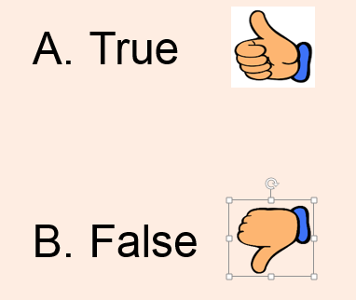
Would this be an authorized use of Title III? #2- After school and/or summer programs, such as those that offer high intensity language training for ELs, after hours or during the summer
Notes:
Here is our second scenario:
READ
Now, please hold your thumbs up to select A, True, if you think this is an authorized use of Title III funds and thumbs down for B, False if you think it is not.
HOLD FOR DATA
Most of us thought it was authorized. Did anyone think differently? Would you like to share your thoughts?
DISCUSS
Yes, it is authorized if the LEA can demonstrate that these programs are above and beyond what is provided for by the school, LEA, and State. This summer school would have to allow ELs to also participate in other summer school sessions offered in the programs for which they qualify, since ELs qualify for both Title I and Title III.
For example, the LEA offers a Title I funded two-week summer school session from 9:00 a.m.–noon. ELs receive an English Language Development summer school session from 1:00–2:00 p.m. These students must be allowed to attend the Title I funded summer school as well and should not have to choose or be excluded from the Title I offering.

Slide 25
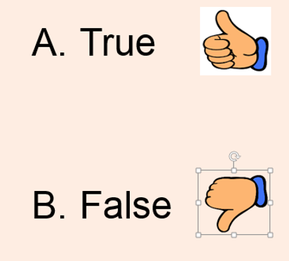
Would this be an authorized use of Title III? #3- Textbooks that serve as an English learner’s primary math or language arts textbook
Notes:
Here is our next scenario:
READ
Now, please hold your thumbs up to select A, True, if you think this is an authorized use of Title III funds and thumbs down for B, False if you think it is not.
HOLD FOR DATA
Most of us thought it was not authorized. Did anyone think differently? Would you like to share your thoughts?
DISCUSS
No, it is not authorized. The LEA is responsible to provide the core educational program for all students as basic civil rights law requires.
Note: In the scenario above, if two sets of books per subject were to be used in a classroom, one English set and one Spanish set, a textbook in one language could be core and the other could be supplemental. However, this might not apply in the case of a dual language program.

Slide 26
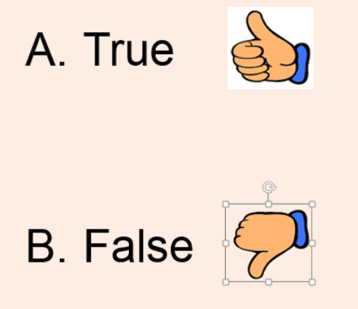
Would this be an authorized use of Title III? #4- Supplementary textbooks or reference guides that supplement an English learner’s primary textbook
Notes:
Here is our next scenario:
READ
Again, please hold your thumbs up to select A, True, if you think this is an authorized use of Title III funds and thumbs down for B, False if you think it is not.
HOLD FOR DATA
Most of us thought it was authorized. Did anyone think differently? Would you like to share your thoughts?
DISCUSS
Yes it is authorized, if the LEA can demonstrate that the textbooks are supplemental in nature.

Slide 27
Would this be an authorized use of Title III? #5- Stipend to teachers to assess newly enrolled students for English language proficiency
Notes:
Here is our next scenario:
READ
Please hold your thumbs up to select A, True, if you think this is an authorized use of Title III funds and thumbs down for B, False if you think it is not.
HOLD FOR DATA
Most of us thought it was not authorized. Did anyone think differently? Would you like to share your thoughts?
DISCUSS
No, it is not authorized. The LEA is obligated to assess the English language proficiency of students identified when the Home Language Survey indicates a language other than English exists in the student’s experience. LEAs sign an assurance to do this. State and local funds are used to avoid supplanting.

Slide 28
Would this be an authorized use of Title III? #6- ELD instructional coach whose duty is to administer the English language proficiency assessment for placement and identification
Notes:
Here is our next scenario:
READ
Please hold your thumbs up to select A, True, if you think this is an authorized use of Title III funds and thumbs down for B, False if you think it is not.
HOLD FOR DATA
Most of us thought it was not authorized. Did anyone think differently? Would you like to share your thoughts?
DISCUSS
No, it is not authorized. The LEA is obligated to assess the English language proficiency of students. However, if the LEA can demonstrate that this position has other duties that are supplemental, it may be authorized to utilize Title III funds for a portion of the coach’s salary to support duties unrelated to English language proficiency (ELP) assessment administration, but related to Title III as supplemental activities aligned with the purposes and goals of Title III.

Slide 29
Would this be an authorized use of Title III? #7- Data clerk who enters data for Title III and Migrant Education
Notes:
Here is our next scenario:
READ
Please hold your thumbs up to select A, True, if you think this is an authorized use of Title III funds and thumbs down for B, False if you think it is not.
HOLD FOR DATA
Most of us thought it was not authorized. Did anyone think differently? Would you like to share your thoughts?
DISCUSS
No, it is not authorized. A portion of the data clerk’s salary can be charged to the 2 percent administration costs if the support is only for Title III. If the data clerk provides support to other Federal programs or general education programs, such as Migrant, then each supplemental fund may be used as defined in the purposes. However, if other schools or locations have a clerk do the same activity with general program or other funds, Title III cannot be used as it would be supplanting.

Slide 30
Would this be an authorized use of Title III? #8- Consultant fees for consultant to deliver professional development session focused on ELD
Notes:
Here is our next scenario:
READ
Please hold your thumbs up to select A, True, if you think this is an authorized use of Title III funds and thumbs down for B, False if you think it is not.
HOLD FOR DATA
Most of us thought it was authorized. Did anyone think differently? Would you like to share your thoughts?
DISCUSS
Yes, it is authorized. Professional development (PD) under Title III must be of sufficient intensity and duration to have a lasting impact on the teachers’ performance in the classroom. It can be part of an overall comprehensive PD program, but it still must be supplemental in that it addresses specific Title III supplemental activities.

Slide 31
Would this be an authorized use of Title III? #9- ELD curriculum development
Notes:
Here is our next scenario:
READ
Please hold your thumbs up to select A, True, if you think this is an authorized use of Title III funds and thumbs down for B, False if you think it is not.
HOLD FOR DATA
Most of us thought it was authorized. Did anyone think differently? Would you like to share your thoughts?
DISCUSS
Yes it is authorized, if the LEA can demonstrate that this curriculum development is new, supplemental and/or is not required by the school, LEA, and State for core instruction. An LEA can also fund a pilot or any other activity that involves reviewing and upgrading curricula. As long as the curricula is not currently being used as core curricula, it is an authorized expenditure.

Slide 32
Would this be an authorized use of Title III? #10- A district proposes to use Title III funds to support the salary of a site administrator who will, as part of his/her duties, administer district Title III-funded activities
Notes:
Here is our last scenario:
READ
Please hold your thumbs up to select A, True, if you think this is an authorized use of Title III funds and thumbs down for B, False if you think it is not.
HOLD FOR DATA
Most of us thought it was not authorized. Did anyone think differently? Would you like to share your thoughts?
DISCUSS
This is not authorized. Site administrators are core to the educational program and are provided by the general education program. No part of their salary can be charged to Title III.
Duties beyond their contract or contract-type activities for site administration might be able to be charged to the 2 percent administrative costs, but this is a slippery slope.

Slide 33
Authorized Immigrant Subgrantee Activities
What are the seven authorized Immigrant subgrantee activities?
Find a partner and pick an authorized activity card
Discuss:
Possible examples of what the activity might look like at a site
Any AHA!s
Notes:
You also have a document entitled Examples of Title III Immigrant authorized Uses. It lists the seven authorized subgrantee activities for the Immigrant program. You can also find them on the blue handout for US Code 6825 in part (e).
Take a minute to quickly review and then find a partner. Once you find a partner, take a green “authorized activity” card from the table and begin discussing examples or AHA!s.
[DISCUSS: Now we will share our discussions with the group, starting with the first authorized activity listed: (A) Family literacy, parent and family outreach, and training activities ]
Remember:
Title III Immigrant funds are distinct from Title III EL funds and should be used for authorized purposes, specifically for immigrant students. These funds should not be used on all EL students, but should supplement Title III EL funds in cases where a student is entitled to both EL and Immigrant funds.

Slide 34
Advance Organizer – True or False?
LEAs may not use Title III funds for the annual parental notification on their child’s placement in a language instruction educational program.
There are 3 required activities LEAs receiving Title III funds must carry out. (Extra credit – name the activities!)
All LEAs in a State must implement State ELP standards.
When LEAs use Title III funds for professional development , they may only serve teachers who are designated EL teachers.
LEAs will have to report on the number and percentage of ELs who have exited services for two years after these students are no longer receiving Title III services.

Slide 35
Advance Organizer – Answers
1. LEAs may not use Title III funds for the annual parental notification on their child’s placement in a language instruction educational program. - FALSE
LEAs may use Title III funds for the parental notification on EL identification that is now required under Title I, Part A (previously under Title III).
A State and its LEAs may use Title III funds for activities relating to ELs that were previously required under Title III and are now required under Title I as long as:
specific use of funds consistent with the purpose of Title III and meets Federal guidelines for “reasonable and necessary costs.”
specific use of funds is supplemental to the SEA’s or LEA’s civil rights obligations to ELs under Title VI and the EEOA; and
SEA or LEA also uses Title III funds for activities required under Title III.
Title I requires that every LEA that uses funds under either Title I or Title III for services to ELs must provide a parent with a notification that outlines their child’s identification as an EL and placement in a language instruction educational program. (See E-5 of the guidance regarding information that must be included in this parental notification.)

Slide 36
Advance Organizer – Answers
2. There are 3 required activities LEAs receiving Title III funds
must carry out. (Extra credit – name the activities!) - TRUE
Under section 3115(c)(1)-(3) of the ESEA, an LEA receiving Title III funds must provide:
Effective professional development.
An effective language instruction educational program (LIEP)
(but be aware of supplanting prohibition).
Other effective activities and strategies that enhance or supplement LIEPs for ELs, which much include parent, family, and community engagement activities.

Slide 37
Advance Organizer – Answers
3. All LEAs in a State must implement State ELP standards. - TRUE Section 1111(b)(1)(F) requires that “[e]ach State plan shall
demonstrate that the State has adopted English language proficiency standards that [are derived from 4 domains, address proficiency levels, and are aligned to content standards]”, and section 1111(b)(2)(G) requires that “[e]ach State plan shall demonstrate that [LEAs] in the State will provide for an annual assessment of English proficiency of all English learners in the schools served by [SEA]” and that these assessments “shall be aligned with the State’s English language proficiency standards.”

Slide 38
Advance Organizer – Answers
4.When LEAs use Title III funds for professional development , they may only serve teachers who are designated EL teachers. – FALSE
Professional development provided by either the State or an LEA need not be limited to teachers who teach exclusively ELs, but may be provided to all teachers who have ELs in their classrooms. Title III funds may be used to supplement professional development by an LEA that is already meeting its civil rights obligations.
LEAs must use Title III funds to provide effective professional development for teachers, principals, and other school leaders, administrators, and other organizational personnel.

Slide 39
Advance Organizer – Answers
5. LEAs will have to report on the number and percentage of ELs who have exited services for two years after these students are no longer receiving Title III services. - FALSE
ESEA section 3121(a)(5) requires that LEAs report on the number and percentage of ELs meeting State academic standards for four years after such students are no longer receiving services for ELs.
These data must include results on content assessments for reading/language arts, mathematics, and science.
Students included in this reporting must include all former ELs served by the LEA who have achieved English language proficiency and therefore no longer receive any EL services.
These data must be disaggregated by English learners with disabilities.

Slide 40
2017-2018 Transition Plan Template

Slide 41
2017–18 Title III Transition Plan Template
Notes:
This is the 2017–18 Title III Transition Plan Template, or the “stay at home” template. You also have a copy in your folders. LEAs can use this to ensure that they have an updated plan to take to their local board for approval during this transition year. This template is only intended for use in 2017–18.
As you can see, this template has a similar structure and appearance to our previous template. However, the content of this template has been aligned to ESSA.
Next year, we plan to have instructions to guide LEAs on how to include Title III in the LCAP, an LCAP addendum, or another document of their choosing as they begin work on their plans for 2018–19.
[DISCUSS: Note that the column for Persons Involved/Timeline is optional. LEAs are not required to enter information in this column.]
There are also no budget columns in this template! The new CARS Title III budget pages for the English learner (EL) and Immigrant programs will be operational for the 2017–18 CARS application cycle. We will have more information on that later.
There are two yellow handouts in your folders with mock-up examples of how the Title III CARS budget reports will look, for both the EL and the Immigrant subgrant programs. Let’s take a look at those now.
[DISCUSS: Note that the transition template aligns with the CARS budget report. The categories are listed in the same order on both.]

Slide 42
Title III CARS Budget Web Page
Per pupil amount is pre-populated
Required content from Transition Plan
Notes:
To calculate 2017-2018 allocation, use the Fall Census Day enrollment count for English Learners submitted in CALPADS and multiply by this year’s per pupil amount. EL 2016‒17 Title III, Part A, preliminary per pupil amounts as of March 2017:
➢ EL: $93.37
Immigrant: $80.77

Slide 43
EL Consortia
LEAs with an eligibility less than $10,000 must apply for the Title III EL program as a member of a consortium
One of the members must agree to serve as the consortium lead and will act as the fiscal and program agent
The consortium shall develop a Memorandum of Understanding (MOU)
Notes:
All LEAs that generate a Title III EL student Program subgrant of less than $10,000 in any school year must apply for and participate in the Title III EL student program as a member of a consortium.
One of the LEA members of a consortium must agree to serve as the lead LEA of the consortium. The lead LEA shall be the sole grantee and shall administer the subgrant on behalf of all consortium members. The lead LEA will be responsible for acting as the fiscal and program agent for the consortium and will file the required expenditure reports and maintain fiscal records.
The consortium should develop a Memorandum of Understanding (MOU).
Remember, the consortia requirement and the subsequent process is only applicable to the EL subgrant program. The Immigrant subgrant program does not have consortia status and member LEAs must apply for Immigrant funds separately. They must also maintain their own individual plan for Immigrant funds.

Slide 44
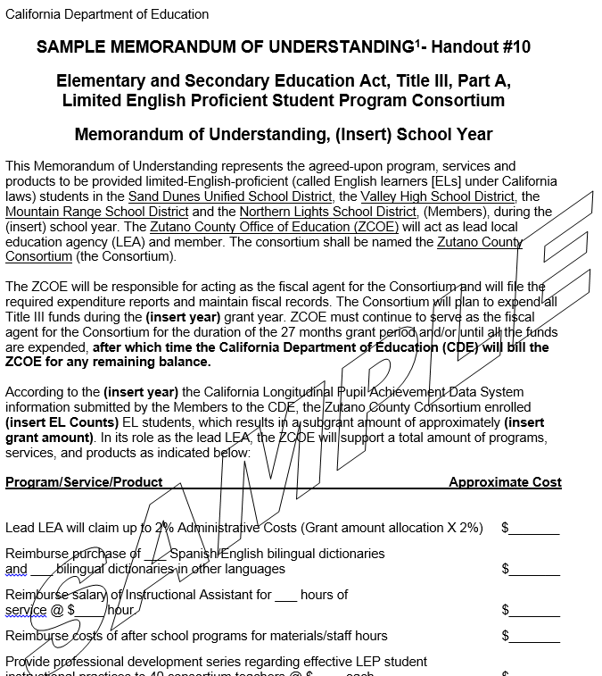
Memorandum of Understanding
Notes:
You have a sample MOU in your folders entitled SAMPLE MEMORANDUM OF UNDERSTANDING. This outlines how the consortium will meet all Title III requirements and describes the activities and timelines for the provision of Title III services to English learners enrolled in the consortium.
Let’s look at that now. A typical MOU includes:
-Services, products, materials for EL/Teachers of ELs
-A total reflecting the LEAs’ grant
-authorized activities
-Dates for providing services, and
-People responsible
Lead LEAs can either develop one MOU for each member to sign (if they all want their own materials, products, programs
Or
The Lead LEA can develop one MOU that all members sign with all members receiving the same products, services or programs, which is the intent. More services can be provided by pooling the funds.
Lead LEAs can select how they want to work, as long as it is all aligned to the purposes of Title III.

Slide 45
Immigrant Funding Changes
For 2017–18 The Title III, Part A, Immigrant Education program funding is changing.
Guidance from the U.S. Department of Education requires CDE to only provide subgrants of sufficient size and scope.
To meet the intent of the law, the CDE will only fund LEAs that have 21 or more eligible immigrant students.
There are no changes to Title III, Part A, EL
program funding.

Slide 46
California and the
Every Student Succeeds Act
Plan Development Update
Bilingual Coordinators Network
May 5, 2017

Slide 47
Givens and Goals
LEAs applying for ESSA funds must develop plans or applications in order to receive those funds.
ESSA plans and applications must be approved by the SBE.
LCAPs approved by county offices of education
California is committed to streamlining and aligning local plans and planning processes to the greatest extent possible.
The SBE would like to encourage LEAs to use ESSA funds to support state priorities to the greatest extent possible.

Slide 48
ESSA Local Planning Requirements
Five ESSA programs include local planning/application requirements:
Title I, Part A
Title I, Part D
Title II, Part A
Title III, Part A
Title IV, Part A
Under No Child Left Behind (NCLB), local planning provisions addressed through LEA Plan
Education Code 52064(b) requires Local Control and Accountability Plan (LCAP) templates allow local educational agencies (LEAs) to meet LEA plan requirements of NCLB, now ESSA
Need mechanism for LEAs to meet ESSA local planning requirements in the
context of LCAP development

Slide 49
LCAP Addendum Development Process
Convened group of district and county office personnel
Matched LCFF State Priorities to ESSA local planning requirements
Found that high-quality LCAPs already address many ESSA provisions
Determined that LEAs should be able to refer to a section of their LCAP to meet ESSA requirements
Discussions and feedback led to the development of the LCAP Addendum
Notes:
ESSA local planning requirements: LEAP

Slide 50
LCAP Addendum Prototype
Supplements LCAP, just as ESSA funds supplement state resources
Includes all ESSA local planning provisions
Includes possible alignment of ESSA provisions with State Priorities
Three options to address ESSA provisions
Notes:
Prototype: Blueprint to the addendum

Slide 51
LCAP Addendum: Sample
Formatted Document
Based on prototype
California Comprehensive Center formatting consistent with LCAP template
One page per ESSA provision
Only a few provisions included in attachment as a sample
Demonstrates slight differences among provisions
Not all provisions have a State Priority Alignment notation
A few provisions include an option to select “N/A”

Slide 52
How provision is addressed
# of Provision
State Priority Alignment
Other Document
LCAP
Addendum
Not applicable
ESSA Section
ESSA Local Planning Provision
LCAP
Title I, Part A
Monitoring Student Progress Towards Meeting Challenging State Academic
Standards
Describe how the local educational agency will monitor students’ progress in meeting the challenging State academic standards by—
developing and implementing a well-rounded program of instruction to meet the academic needs of all students;
identifying students who may be at risk for academic failure;
providing additional educational assistance to individual students the local educational agency or school determines need help in meeting the challenging State academic standards; and
identifying and implementing instructional and other strategies intended to strengthen academic programs and improve school conditions for student learning.
1, 2, 4,  
7, 8
❑
1
1112(b)(1)
(A–D)
9
For each provision, LEAs will need to provide additional information based on how they will address the provision.
If the LEA selects “LCAP” or “Other Document,” they will need to provide a Web link to the document and the goal number or page number where the provision is addressed. If a Web link is not available, the LEA will need to submit the document with their LCAP Addendum. LEAs will also have the option to supplement the information in either of these documents in order to fully meet the ESSA provision.
If the LEA selects “LCAP Addendum”, they will provide a narrative within the LCAP addendum that fully meets the requirements of the ESSA provision.
Notes:
It will not look like this. This is the explanation of the document. ESSA section: the authority the state has to collect this data. N/A only for a few LEA plan provisions that don’t apply to all districts.

Slide 55
Any Questions?
Notes:
Are there any questions?

