Slide 1
Facilities Planning and Funding Support Services for Districts
Debt Advisory Service Team

Slide 2
Debt Advisory Service Team
Mary Barlow Ed.D. Associate Superintendent
John Von Flue Assistant Superintendent
Bill Hornback Attorney, SLS
Mark Fulmer Ed.D. Retired Deputy Superintendent
District Management Advisor
District Financial Advisor

Slide 3
Debt Advisory Service
Services are provided at the request of the local school district Board and Superintendent
Services are provided to you without cost to your district
Information is developed and provided for use by the Board and District staff

Slide 4
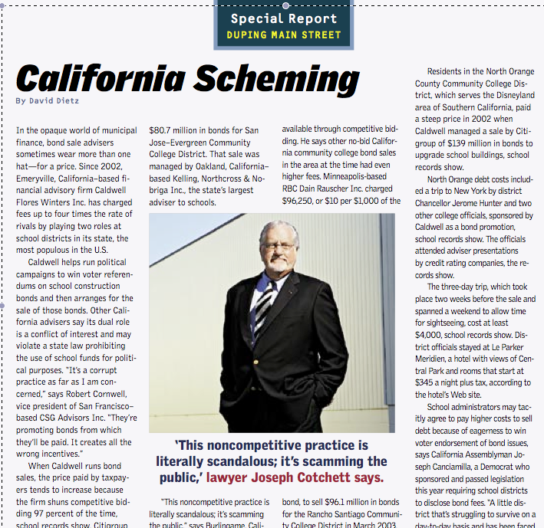
Why Provide Services?

Slide 5
Why Provide Services?
Predatory practices by some advisors
Overly high costs for interest and issuance
Dodd-Frank
Increased SEC and Treasury oversight and enforcement
Increase oversight by County Treasurer
Proactively provide support for local Boards in utilizing Best Practices
Board, not advisors, held responsible
Local boards best understand their local needs

Slide 6
GFOA Best Practices and Advisories
Recommended practices in the public finance to give state and local governments more guidance on sound financial management practices.
Partial listing of GFOA Best Practices
Costs of Issuance Incurred in a Publicly Offered Debt Transaction
Debt Management Policy
Selecting and Managing the Method of Sale of State and Local Government Bonds
Selecting Bond Counsel
Selecting Financial Advisors
Understanding Your Continuing Disclosure Responsibilities
Web Site Presentation of Official Financial Documents
Post Issuance Compliance Checklist

Slide 7
Service and Training Areas
Educational Specifications Process
Facilities Planning Process
RFP/RFQ Process for Facility Planning services
Financial Planning for Facilities Development
RFA/RFQ Process for Architects
RFA/RFQ Process for Financial Advisory Services

